Slide 1
By M.Zakir Khan
Lab 02 Working on Migrating to Next Activity + SetText and GetText
+
Brief touch on Intent

Slide 2
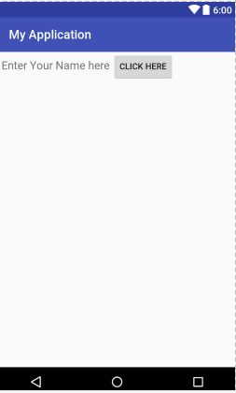
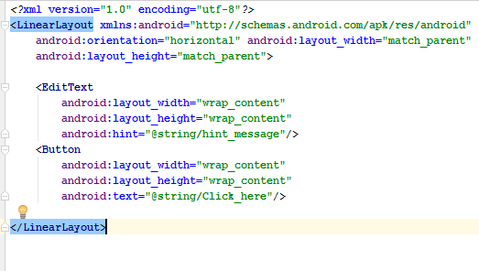
Creating a Simple User Interface

Slide 3
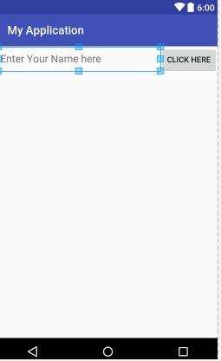
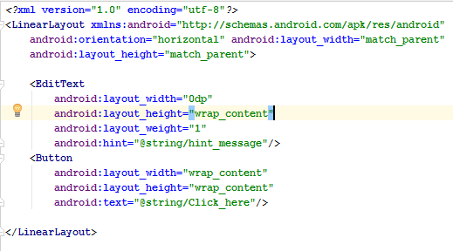
Now after changes

Slide 4
Now Want to Migrate the Edit text Data of First Activity named here SecondActivity and Next Activity named here is FourthActivity

Slide 5
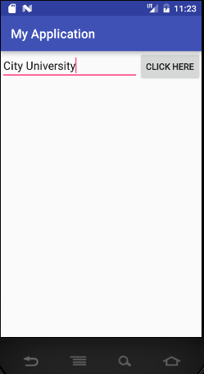
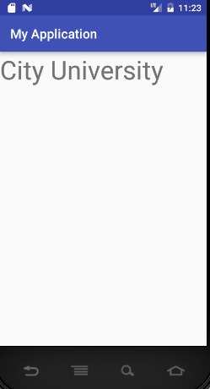

Slide 6
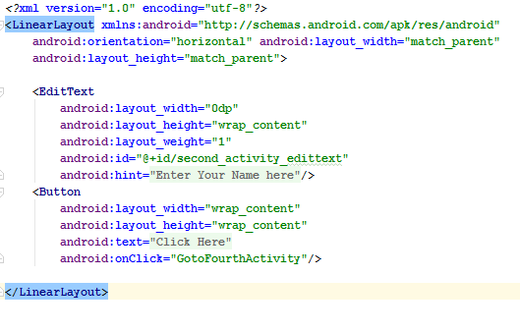
XML code

Slide 7
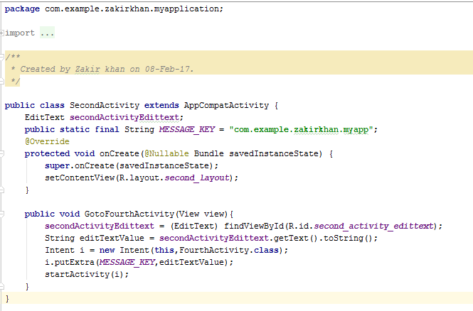
Java Code

Slide 8
Now We get Value from Edit Text and Now want to Migrate to NextActivity

Slide 9
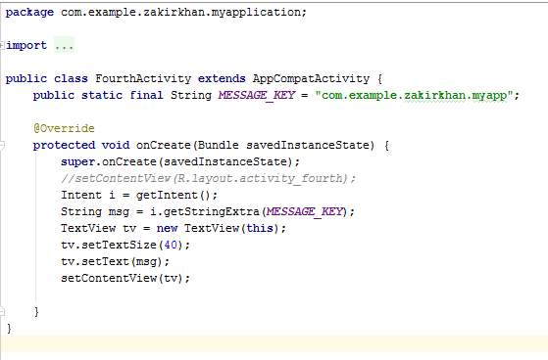
Java Code of Next Activity

Slide 10
Now to Want to Migrate from MainActivity to Second and Third Activity Using Button.

Slide 11
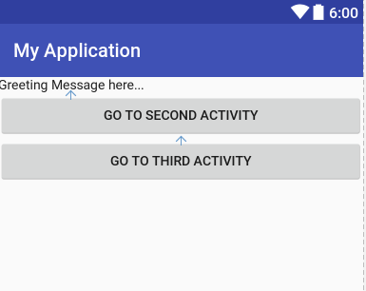
First Program

Slide 12
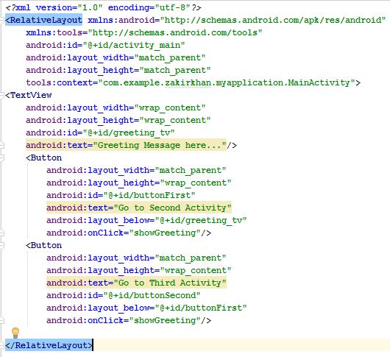
XML Code

Slide 13
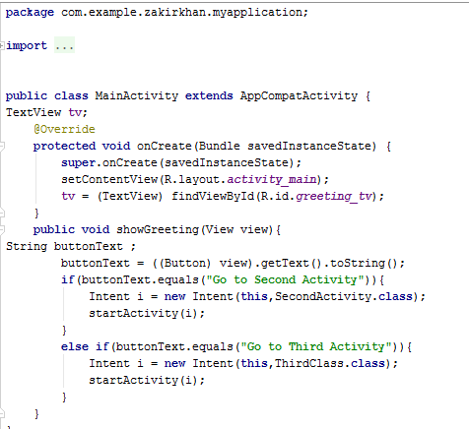
MainActivity code

Slide 14
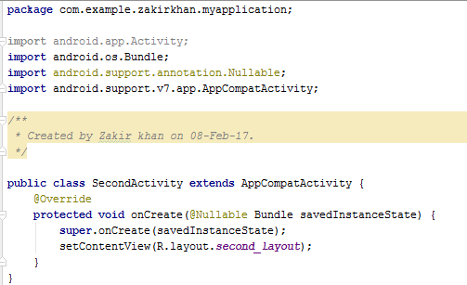
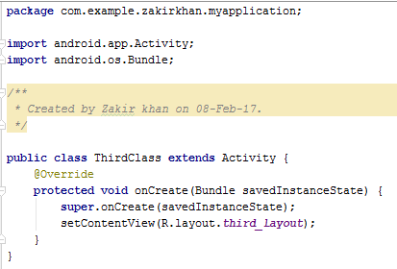
Second Activity and Third Activity Code

Slide 15
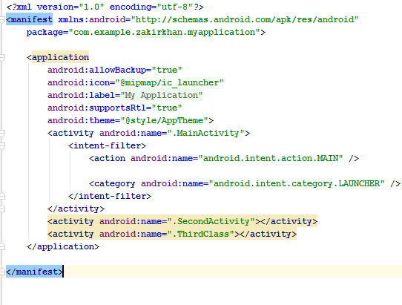
Manifest File Code

Slide 16
Implicit and Explicit Activity

Slide 17
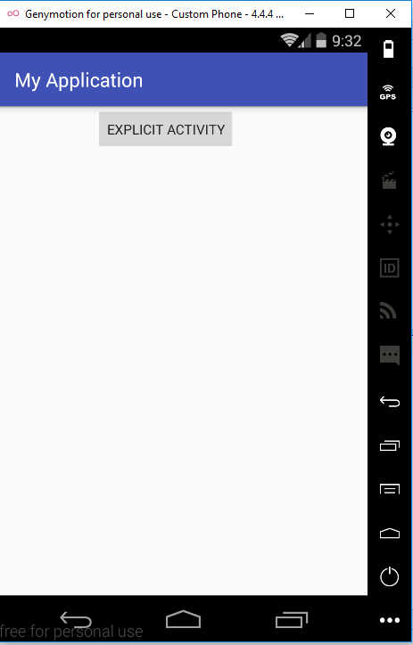
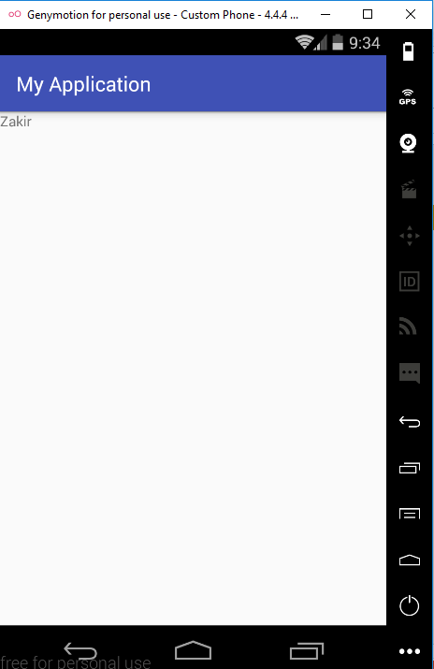
EXPLICIT INTENTS
These intents designate the target component by its name and they are typically used for application-internal messages
- such as an activity starting a subordinate service or launching a sister activity. For example

Slide 18
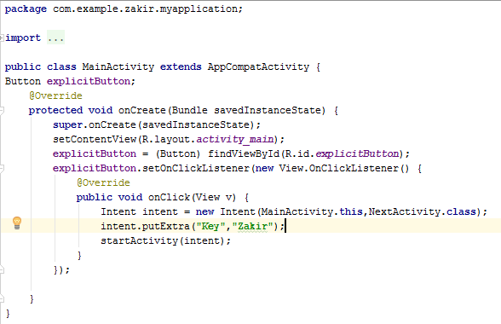
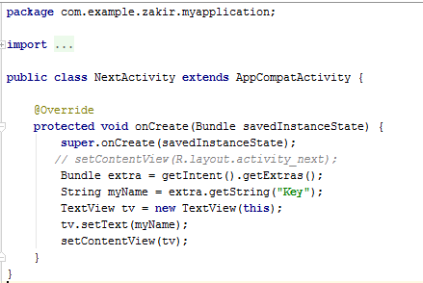
Left side MainActivity.Java and Right Side NextActivtity.java Code

Slide 19
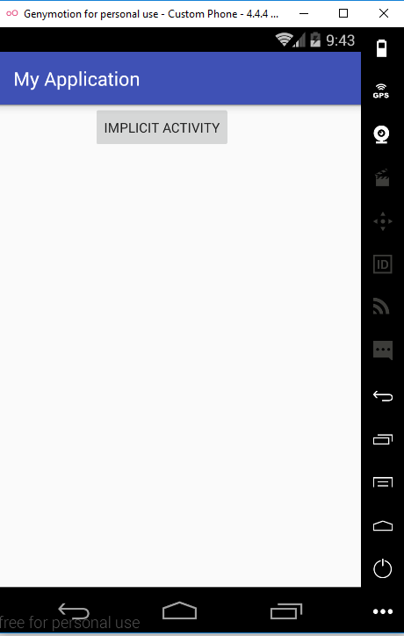
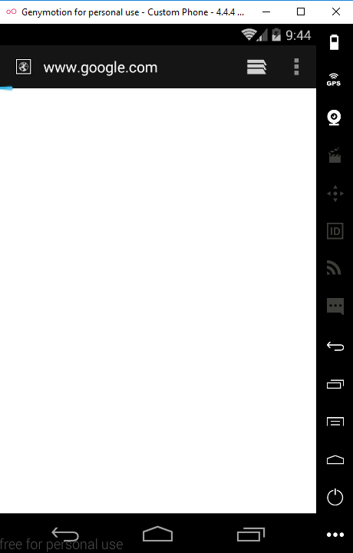
IMPLICIT INTENTS
These intents do not name a target and the field for the component name is left blank. Implicit intents are often used to activate components in other applications. For example:

Slide 20
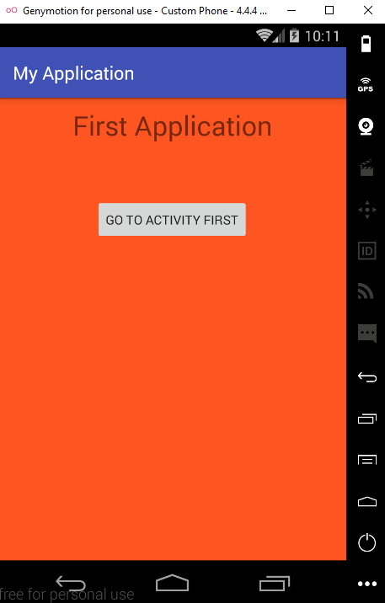
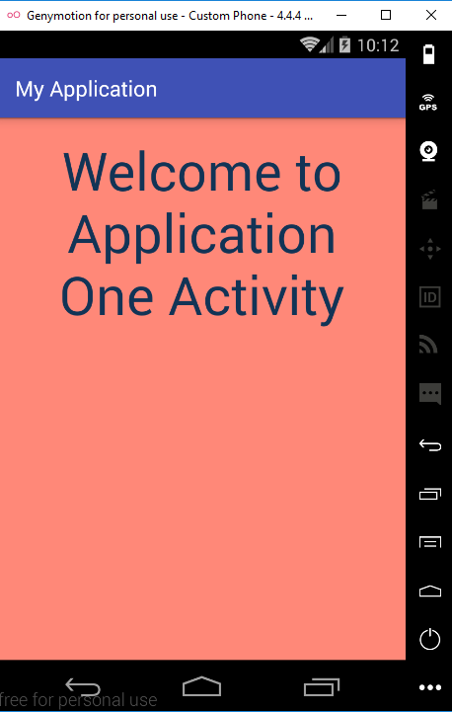
IMPLICIT And Explicit INTENTS (Example 2 )
Suppose I want to make two application. We will call the first Application Activity from the second Activity using Implicit call.
Here is again the example of Explicit Intent Call.

Slide 21
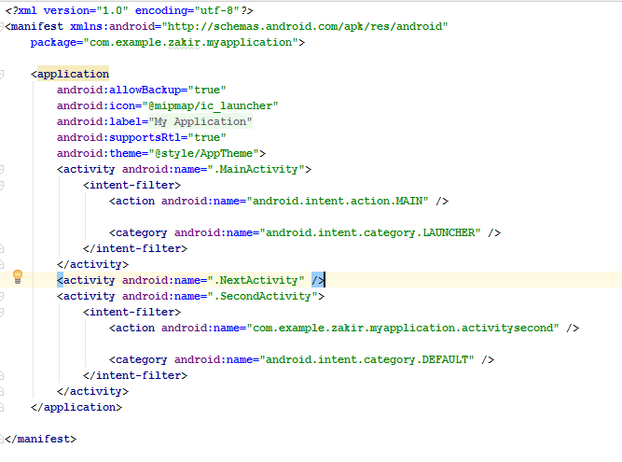
Manifest.xml file changes

Slide 22
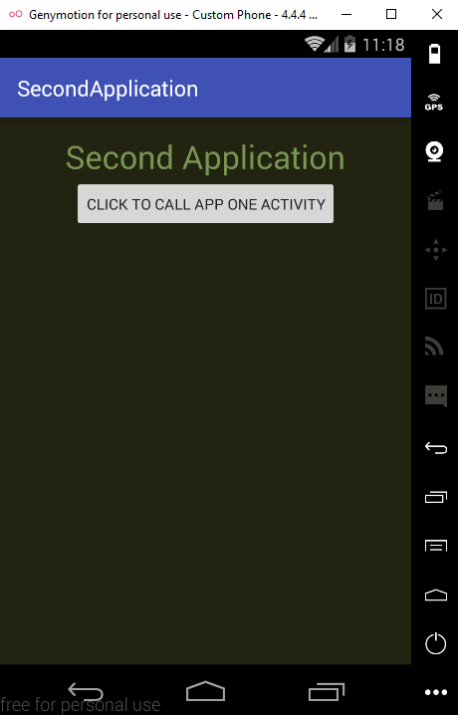
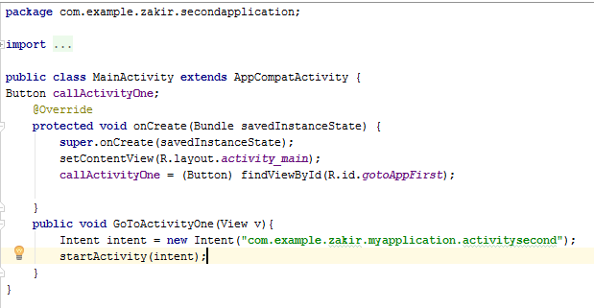
Second Application Activity
When we click on the button CLICK TO CALL APP ONE ACTIVITY it will call the activity of the first App

